Slide 1
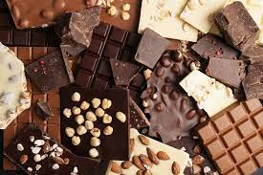
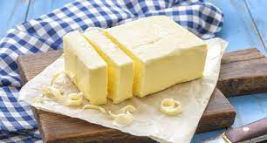
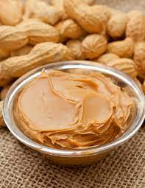
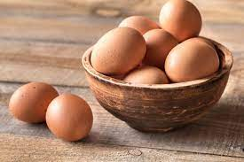
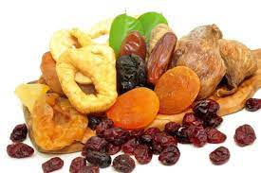
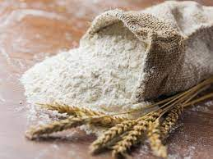
Cookies, treats and cakes for all occasions

Slide 2
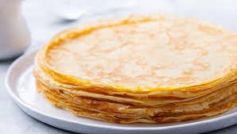
Pancakes
Ingredients:
20 decagrams of flour
2 eggs
2 glass milk
Salt
Sugar
oil
Instruction:
First you sift the flour through a sieve. Next you add eggs, milk, salt and sugar. Then everything you mix and fry in oil. You can eat pancakes with chocolate and banana or jam
Zuzanna Stefanów

Slide 3
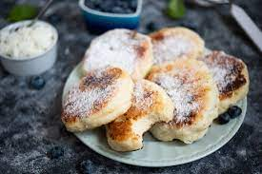
Pancakes with cheese
Instruction: Mix egg yolks with sugar, add cream, flour and cheese. Mix everything into a uniform dough. Beat the egg whites with salt, add to the mixture and mix gently. Fry over low heat.
Ingredients:
50 dag Cottage cheese
3 eggs
Pinch salt
4 tablespoons of sugar
7 tablespoons of flour
3 tablespoons of thick cream
vanilla flavor
Oil
powdered sugar
Zuzanna Stefanów

Slide 4
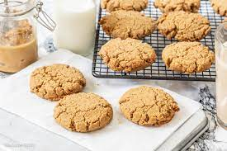
Peanut butter cakes
Ingredients:
1 glass peanut butter (or the whole jar)
¾ glass sugar
Big egg
½ teaspoon of baking soda
1 glass of sliced ​​chocolate, dried fruit, nuts etc.
Instruction:
You heat the oven to 180 degrees centigrade.You mix everything. Spread the baking sheet with paper and put dough rings. Bake for 15 minutes
Zuzanna Stefanów

Slide 5
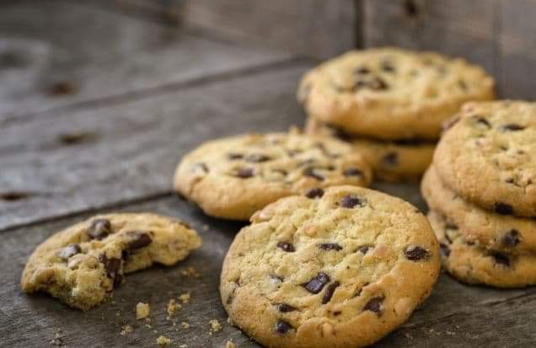
Shortbread Cookies With Chocolate
Ingredients: • 125 g of butter • half a cup of sugar • 250 g of wheat flour •1 egg •1 teaspoon of baking powder • a few drops of vanilla essence • chocolate peas / pieces of dark chocolate
Justyna Janusz

Slide 6
Instruction:
Mix the butter with sugar untifluffy, add the egg and mix everything thoroughly. Then add the dry ingredients, i.e. flour with baking powder, and finally pour a few drops of vanilla essence. Add chocolate peas to the finished mass and gently knead them into a dough. Shape into balls the size of a walnut. Line the baking tray with baking paper and place dough balls on it, gently flattening them. Put in an oven preheated to 180 degrees for 10-12 minutes. After this time, remove and cool on a wire rack. Once they have cooled down slightly, the chocolate chip cookies are ready to be crunchy.

Slide 7
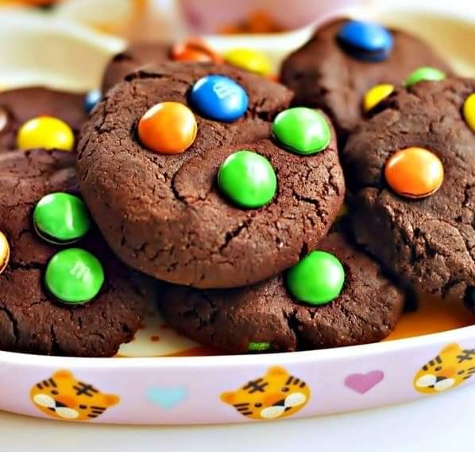
cookies with m&m's
Ingredients: •110 g of dark chocolate •45 g of wheat flour •5 g of cocoa •35 g of butter •1 egg •80 g of brown sugar •half a teaspoon of baking powder •50 g of milk chocolate •100 g of M & M's dragees
Justyna Janusz

Slide 8
1.Preheat the oven to 170 degrees C, line the baking tray with baking paper. 2.In a pot or in a water bath, melt the butter, add chopped dark chocolate. Stir when the chocolate is melted and set aside to cool. 3.Sift flour, cocoa powder and cocoa powder into a bowl. Dice the milk chocolate into cubes and set aside. 4.Mix the egg with the sugar, gradually adding the melted chocolate, stirring constantly. 5.Pour in the flour with cocoa and powder. Stir well, add the chocolate cubes and half of the M & M's (50g), mix everything with a spatula. 6.Put a spoonful of the dough on the baking tray at intervals (the dough will rise during baking and spread a little to the sides). Gently press the remaining M & M's on top. 7.Bake for 10 minutes, after removing from the oven, leave on the baking tray for 5 minutes and transfer to a wire rack until completely cool.
Instruction:

Slide 9
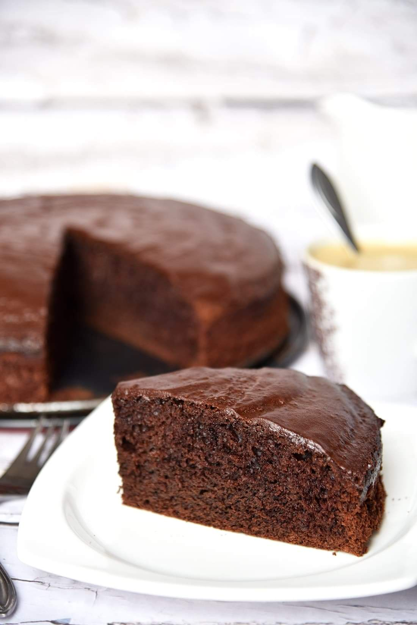
Chocolate cake
Ingredients: 120 g of butter 75 g of dark chocolate 75 g of milk chocolate 100 ml of milk 3 eggs 200 g of sugar 250 g of flour 2 tablespoons of dark cocoa 1 teaspoon of baking powder Additionally: 100 g of dark chocolate 2 tablespoons of butter
Justyna Janusz

Slide 10
Instruction:
All ingredients should be at room temperature. Melt the chocolate and butter in a saucepan over low heat (do not bring it to a boil!). Set aside to cool. Mix the eggs with sugar until light, fluffy. Pour in the milk, the cooled chocolate mass, flour, cocoa and baking powder. We mix everything with a spoon or at low speed of the mixer only until the ingredients are combined. Pour the mass into a springform pan (in my case, 24 cm in diameter) and bake it for 35-40 minutes at 180 degrees to the so-called dry stick. The length of baking will depend on the size of the tray. After baking, prepare the chocolate glaze. In a small pot, melt the chocolate and butter, mix it until a smooth chocolate mass is formed. We pour the prepared glaze over our chocolate cake.

Slide 11
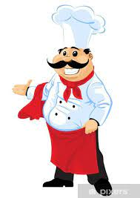
Thank you, for your attention
Zuzanna Stefanów
Justyna Janusz
Klass 7
school year 2021/2022

