Slide 1
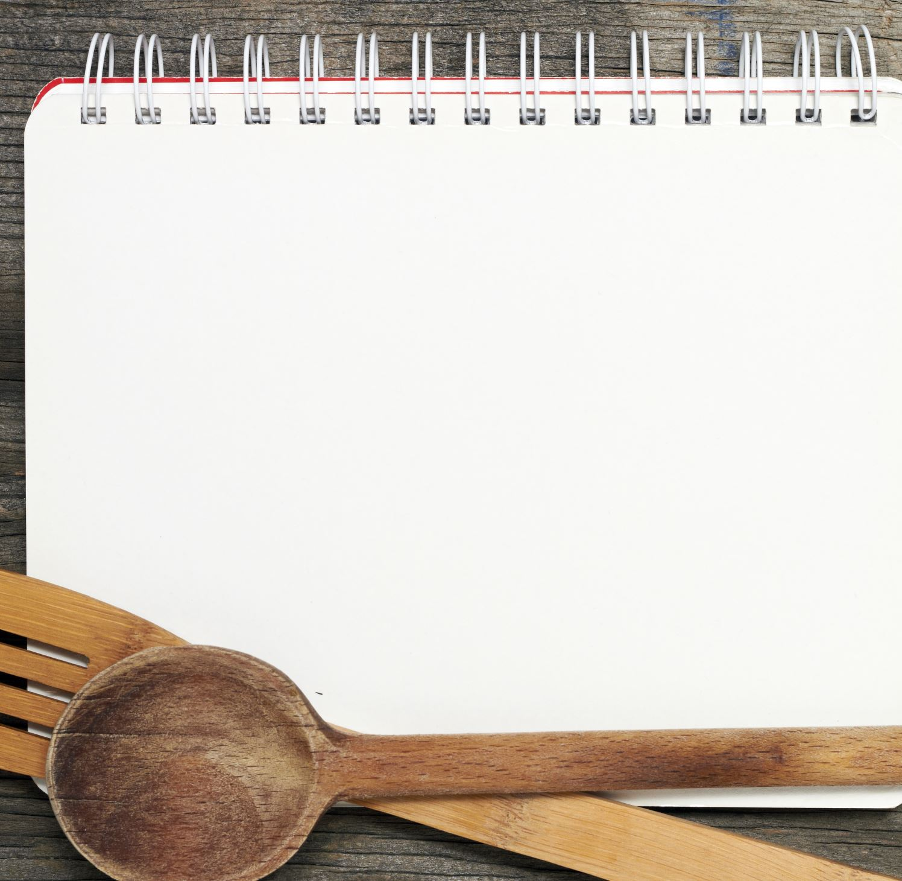
COOKBOOK
Filip K.
Maja C.
Karol K.
Gracjan M.

Slide 2
Spis treści
Breakfasts
Dinners
Suppers
Desserts

Slide 3
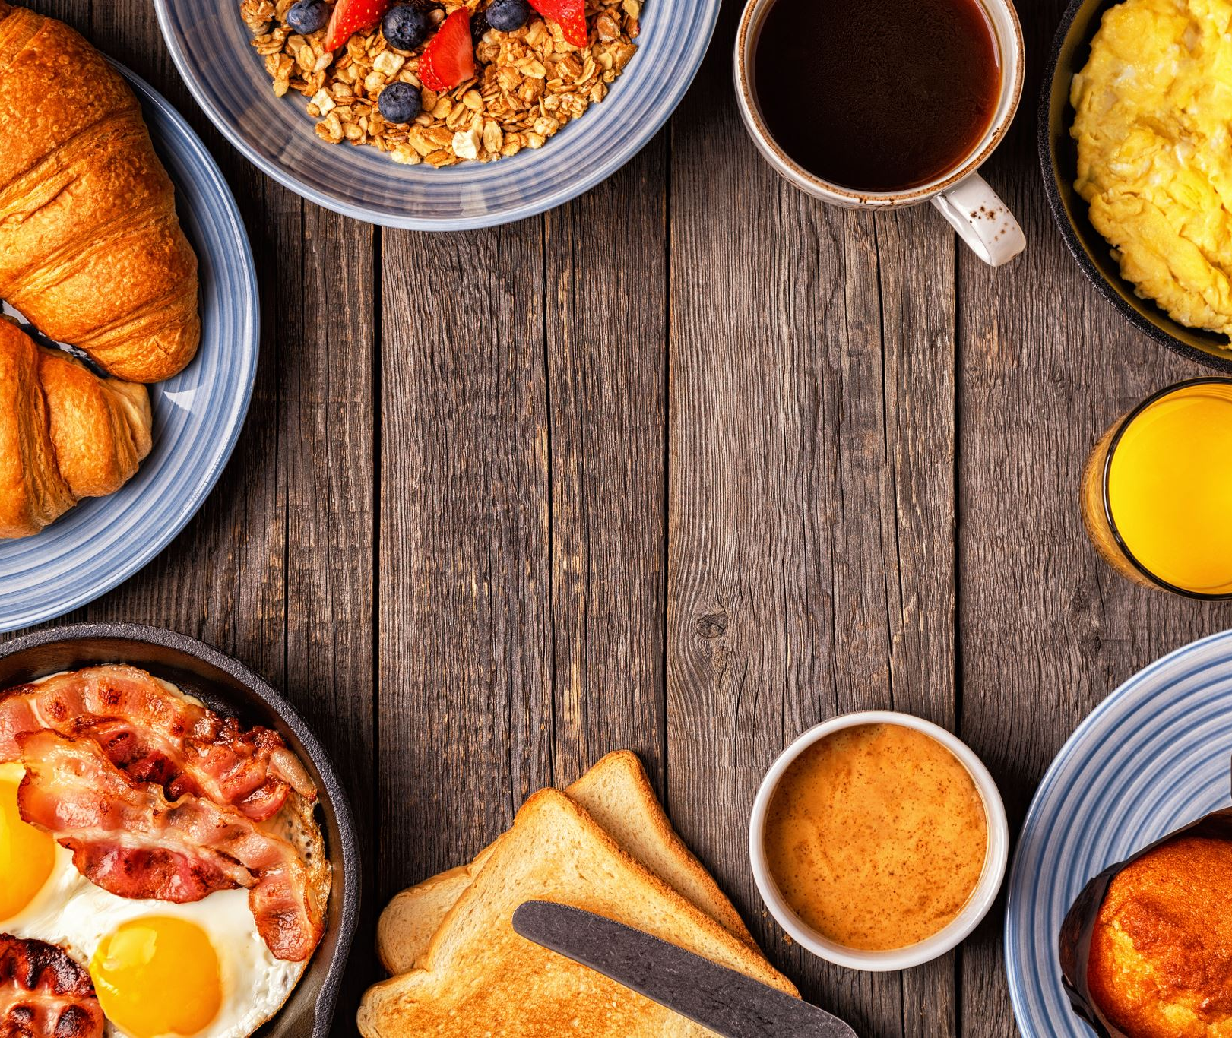
breakfast

Slide 4
French toast
Put the eggs on a deep plate, pour in the milk, pour sugar and cinnamon and mix everything. Cut the challah into slices 2-3 cm thick. you can cut along the middle and put a cube of chocolate there during frying, the chocolate will dissolve and the toast will gain a liquid chocolate filling. Then soak the slices in milk with eggs. The drier the challah is, the tastier it will be, as it will absorb more milk. Hold the slices in the milk on each side for at least 15-20 seconds so that the center has to get wet. We heat the butter in a pan and when it dissolves, we put our wet slices on it. Fry on each side on a not very strong fire for a few minutes. When they are golden, we pull out the toast on a plate. We serve immediately while hot. Enjoy your meal
Ingredients:
two small dry challahs
2 eggs
150 ml of milk
a teaspoon of sugar
a little cinnamon
2 tablespoons butter
additive suggestions: jam, powdered sugar, chocolate, fresh fruit, yogurt, cream

Slide 5
banana pancakes
We put peeled, ripe bananas (2 larger pieces) in a bowl. We also add the yolks and crush the whole with a fork. Beat the egg whites to a stiff foam along with a small pinch of salt. This should take a minimum of 3 minutes. Add flour to the bananas with yolk and mix thoroughly and then add the beaten protein. Now we mix. Congratulations, it was only left to fry them. Pour a little oil into the pan and fry on both sides over low heat until golden. Enjoy your meal.
ingredients
3 eggs
2 bananas
3 flat tablespoons of wheat flour

Slide 6
Dinner

Slide 7
Recipe for chicken breast in cream and herbal sauce
Ingrediens
-500g chicken breast
-one pack of garbage and herbal sauce
-two bags of rice
-cream
First cut chicken to squares and put it in the pan.
Fry it until they go white (5-7 minutes)
To make sauce you need mix pack of sauce with one spoon of cream and water (u can put it in meat)
Then pour water on it
When the meat will be soft - that means its ready
Rice should boil 10 minutes on boiling water
Put on a plate
And done :D
Enjoy your meal

Slide 9
Supper

Slide 10
Scrambled eggs
Ingridients
3 eggs
Pepper
Salt
Put 3 eggs, pepper and salt in a cup and mix. Pour into the pan. when you pour the scrambled eggs into the pan, start mixing. After 5 minutes the scrambled eggs are ready.

Slide 11
Pancakes
Ingredients:
Milk 500 ml
Flour 400 g
Wather 300 ml
Oil 100 ml
2 eggs
Sugar 5 g
Salt 4g
add flour, milk, water, eggs, sugar, salt to a large bowl and mix. when we have it mixed up, we add oil. we warm up the pans. when the pan is already hot, pour the dough over the pancakes and fry.

Slide 12
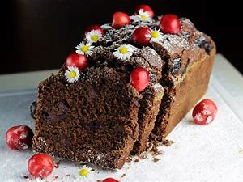
dessert

Slide 13
Cookies
Ingrediends
1 cube of soft butter
1 cup of sugar
1 egg
2.5 cups flour
0.5 teaspoon soda
0.5 teaspoon salt
1.5 chocolate bars
rate the butter with sugar, add the egg and mix the rest of the ingredients, add chocolate to the mass. Preheat the oven to 200 degrees, from the mass form balls bake 10-15 minutes.

Slide 14
cold dough
ngredients
Pack of sponge cakes
whipped cream powder
Jelly fruit
ut the sponge cakes on a baking tray, beat the snowball and add to it the jelly made in 1/2 cup of water and cooled pour into a baking tray then put in the refrigerator. When the mass is concentrated, you can lay the fruits and pour jelly over them.

